Slide 1
Linear Programming
Linear programming (LP) is a method of spreadsheet optimization.
LP is used in all type of organizations and it is used to solve an extremely wide variety of problems

Slide 2
Introduction to Optimization
Common elements of all optimization problems
  Decision Variables - the variables whose values the decision maker is allowed to choose.
  Objective Function - value that is to be optimized – maximized or minimized
  Constraints that must be satisfied
Excel terminology for optimization
  Decision variables = changing cells
  Objective = target cell
  Constraints impose restrictions on the values in the changing cells.

Slide 3
A common form for a constraint is nonnegativity
Nonnegativity constraints imply that changing cells must contain nonnegative values.
Two steps in solving an optimization problem.
  Model development – decide what the decision variables are, what the objective is, which constraints are required and how everything fits together
  Optimize – systematically choose the values of the decision variables that make the objective as large or small as possible and cause all of the constraints to be satisfied.

Slide 4
A feasible solution is any set of values of the decision variables that satisfies all of the constraints.
The set of all feasible solutions is called the feasible region.
An infeasible solution is a solution where at least one constraint is not satisfied.
The optimal solution is the feasible solution that optimizes the objective.

Slide 5
An algorithm is basically a “plan of attack”. It is a prescription for carrying out the steps required to achieve some goal.
The simplex method is an algorithm that is suitable for linear models.
Excel’s Solver tool finds the best feasible solution with the most suitable algorithm.
There is really a third step in the optimization process: sensitivity analysis. This step allows us to ask a number of what-if questions about the completed model.

Slide 6
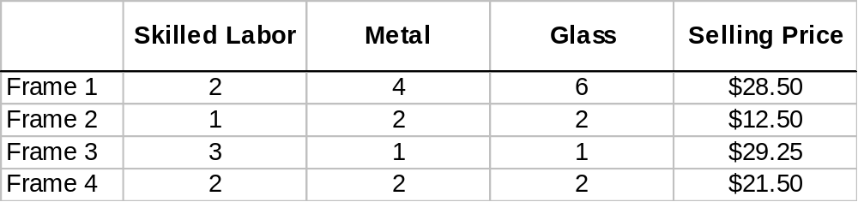
Example: Background Information
The Monet Company produces four types of picture frames, which we label 1, 2, 3, and 4. The four types of frames differ in respect to size, shape, and materials used.
Each type requires a certain amount of skilled labor, metal, and glass as shown here. The table also lists the unit selling price Monet charges for each type of frame.

Slide 7
Background Information -- continued
During the coming week Monet can purchase up to 4000 hours of skilled labor, 6000 ounces of metal, and 10,000 ounces of glass.
The unit costs are $8.00 per labor hour, $0.50 per ounce of metal and $0.75 per ounce of glass.
Also, market constraints are such that it is impossible to sell more than 1000 type 1 frames, 2000 type 2 frames, 500 type 3 frames, and 1000 type 4 frames.
The company wants to maximize its weekly profit.

Slide 8
Solution
In the traditional algebraic solution method, we first identify the decision variables.
In this small problem they are the number of frames of type 1, 2, 3, and 4 to produce.
We label these x₁, x₂, x₃, and x₄.
Next, we write total profit and the constraints in terms of x’s.
Finally, since only nonnegative amounts can be produced, we add explicit constraints to ensure that the x’s are nonnegative.

Slide 9
Solution -- continued
The resulting algebraic formulation is shown below:
  maximize 6x₁ + 2x₂ + 4x₃ + 3x₄ (profit objective)
  subject to 2x₁ + x₂ + 3x₃ + 2x₄ < = 4000 (labor constraint)
  4x₁ + 2x₂ + x₃ + 2x₄ < = 6000 (metal constraint)
  6x₁ + 2x₂ + x₃ + 3x₄ < = 10,000 (glass constraint)
  x₁ < = 1000 (frame 1 sales constraint)
x₂ < = 2000 (frame 2 sales constraint)
x₃ < = 500 (frame 3 sales constraint)
x₄ < = 1000 (frame 4 sales constraint)
x₁, x₂, x₃, x₄ > = 0 (nonnegative constraint)

Slide 10
Solution -- continued
To understand this formulation, consider the profit objective first.
  The profit from x₁ frames of type 1 is 6x₁ because each frame contributes $6 to profit. This $6 is calculated as the unit selling price minus the cost of the inputs that go into a single type 1 frame:
  Unit profit = 28.50 - [2(8.00) + 4(0.50) + 6(0.75)] = $6
  Profits for the other three types are obtained similarly. Their unit profits are $2.00, $4.00, and $3.00, respectively.
  Then the total profit is the sum of the profits from the four products.

Slide 11
Solution -- continued
Next, consider the skilled labor constraint.
  The right hand side, 4000, is the number of hours available. On the left-hand side each type 1 frame uses 2 hours of labor, so x₁ units require 2x₁ hours of labor.
  Similar statements hold for the other three products, and the total number of labor hours used is the sum over the four products.
  Then the constraint states that the number of hours cannot exceed the number of hours available.

Slide 12
Solution -- continued
The constraints of metal and glass are similar.
Finally, the maximum sales constraints and the nonnegativity constraints put upper and lower limits on the quantities that can be produced.
For many years all LP problems were formulated this way.
Because of this, many commercial LP computer packages are written to accept LP problems in this format.

Slide 13
Solution -- continued
In the past decade a more intuitive method of expressing LP problems has emerged.
The method takes advantage of the power and flexibility of spreadsheets.
Actually, LP problems could always be formulated on spreadsheets, but now with the addition of Solver add-ins, spreadsheets have the capability of solving LP problems as well.
There are many ways to develop an LP spreadsheet model.

Slide 14
Spreadsheet Elements
The common elements in all LP spreadsheet model are the following:
  Inputs. All numerical inputs - that is, the data needed to form the objective and the constraints - must appear somewhere in the spreadsheet. It is not necessary but it often helps to enclose inputs in a blue border with shading.
  Changing cells. Instead of using variable names, such as x’s, there is a set of designated cells that play the role of the decision variables. These values in these cells can be changed to optimize the objective. In Excel these cells are called the changing cells. To designate these we often enclose them in a red border.

Slide 15
Spreadsheet Elements -- continued
  Target (objective) cell. One cell, called the target cell or the objective cell, contains the value of the objective. Solver systematically varies the values in the changing cells to optimize the value in the target cell. Our convention is to enclose the target cell within a black double line border.
  Constraints. Excel does not show the constraints directly on the spreadsheet. Instead we specify constraints in a Solver dialog box.
  Nonnegativity. Normally we want the decision variables - that is, the values in the changing cells - to be nonnegative. For certain versions of Excel these nonnegativity constraints might need to be specified explicitly.

Slide 16
Solution -- continued
In general, the complete solution to the problem involve three stages.
The first stage is to enter all the inputs, trial values for the changing cells, and formulas relating these in a spreadsheet. We call this formulating the model.
  This stage if the most crucial because it is here that all of the “ingredients” of the model are included and related appropriately.
  In particular, the spreadsheet must include a formula that relates the objective to the changing cells, so that if the values in the changing cells vary, the objective value varies automatically.

Slide 17
Solution -- continued
After the model is formulated, we can proceed to the second stage: invoking Solver. At this point we formally designate the objective cell, the changing cell, and the constraints, and we tell solver to find the optimal solution.
  If the first stage is done correctly, the second stage is usually very straightforward.

Slide 18
Solution -- continued
The third stage is sensitivity analysis. A study of the effect of a change in one or more input variables on a proposed solution
There is typically some uncertainty about quantities such as the unit prices, forecasted demands, and resource availability.
  When we use Solver to solve he problem, we use our best estimates of these quantities to obtain an optimal solution.

Slide 19

Product mix problem
This file illustrates the solution procedure for Monet’s product mix problem.
The first stage is to set up the spreadsheet, as explained in step-by-step fashion.

Slide 20
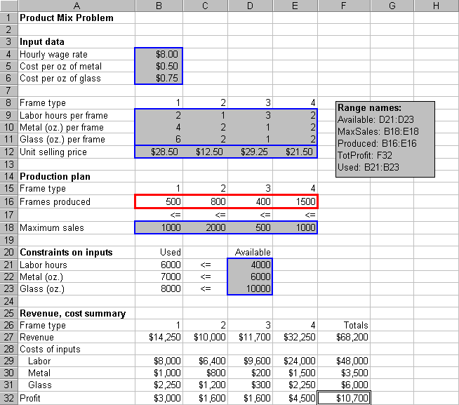

Slide 21
Developing the Spreadsheet Model
Inputs. Enter the various inputs in the range B4:B6, B9:E12, B18:E18, and D21:D23.
Production levels. Enter any four values in cells B16:E16. These do not have to be the values shown in 14.1. These cells are the changing cells; that is, the cells where the decision variables are placed. Any trail values can be used initially; Solver will eventually find the optimal values. Note that the four values shown in the initial solution cannot be optimal because they do not satisfy all of the constraints.

Slide 22
Developing the Spreadsheet Model -- continued
Resources used. Enter the formula
=SUMPRODUCT(B9:E9,Produced)
in cell B21 and copy it to the range B22:B23. These formulas calculate the units of labor, metal, and glass used by the current product mix. The SUMPRODUCT function is particularly helpful: it multiplies each value in the range by the corresponding value in the Products range and then sums these products.

Slide 23
Developing the Spreadsheet Model -- continued
Revenues, costs and profits. The area from row 25 down shows the summary of monetary values. Actually, all we need is the total profit in cell F32, but it is useful to calculate the ingredients of this total profit (that is, the revenues and costs associated with each product). To obtain the revenues enter the formula =B12*B16 in cell B27 and copy this to the range C27:E27. For the costs, enter the formula =$B$4*B$16*B9 in cell B29 and copy this to the range B29:E21.

Slide 24
Developing the Spreadsheet Model -- continued
Revenues, costs and profits - continued. Then calculate profits for each product by entering the formula =B27-SUM(B29:B31) in cell B32 and copy this to range C32:E32. Finally, calculate the totals in column F by summing across each row with the SUM function.
The next step is to specify the changing cells, the objective cell, and the constraints in a Solver dialog box, and to instruct Solver to find the optimal solution. Before we do this, it is useful to try a few guesses in the changing cell.

Slide 25
Developing the Spreadsheet Model -- continued
Trying a few guesses has two purposes.
  First, by entering different sets of values in the changing cells, we can confirm that the formulas in the other cells are working properly.
  Second, is to provide a better understanding of the model
The resulting solution appears next.
The corresponding profit is $8750.

Slide 26
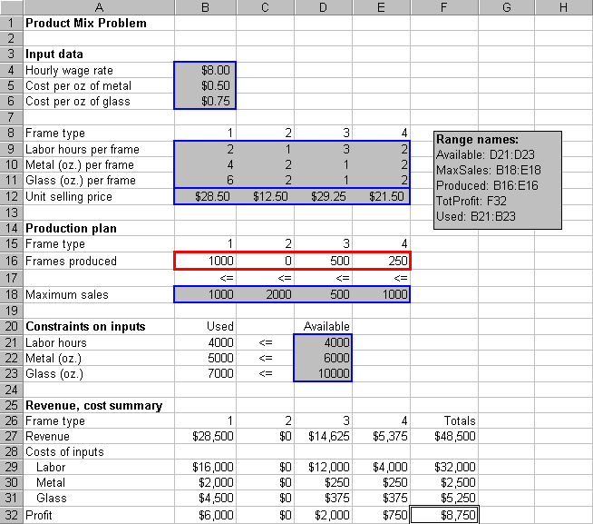

Slide 27
Solution -- continued
We have now produced as much as possible of the three frame type with the three highest profit margins. Does this guarantee that this solution is the best possible product? Unfortunately, it does not!
The solution is not optimal. Even in this small model it is difficult to guess the optimal solution, even when we use a relatively intelligent trial and error procedure.
The problem is that a frame type with a high profit margin can use up a lot of the resources and preclude other profitable frames from being produced.

Slide 28
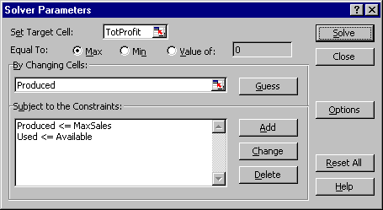
Using Solver
To invoke Excel’s Solver, select the Tools/Solver menu item. This dialog box appears.

Slide 29
Using Solver -- continued
It has three important sections that you must fill in: the target cell, the changing cells, and the constraints.
For the product mix problem, we can fill these in by typing cell references or we can point, click and drag the appropriate range in the usual way.
  Objective. Select TotProfit (cell F32) as the target cell, and click on the Maximize button.
  Changing cells. Select the Produced range (B16:E16), the numbers of frames to produce, as the changing cells.

Slide 30
Using Solver -- continued
  Constraints. Click on the Add button to add the following constraints:
  Used <= Available
  Produced < = MaxSales
  The first constraint says to use no more of each resource than is available. The second constraint say to produce no more of each product than can be sold.
  Nonnegativity. Although negative production quantities obviously make no sense, we must tell Solver explicitly to make changing cells nonnegative. There are two ways to do this:

Slide 31
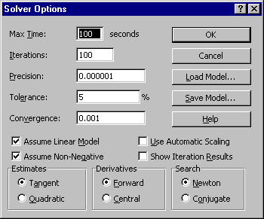
Using Solver -- continued
First, we can add another constraint in Step 3:
Produced >=0.
Second, Excel 97 we can click the options button in the Solver dialog box and we can check the Assume Non-negative box in the resulting dialog box (see here).

Slide 32
Using Solver -- continued
  Linear model. There is one last step before clicking on the Solve button. Solvers uses one of the several numerical methods to solve various type of problems. Linear problems can be solved most efficiently by the simplex method. We must check the Assume Linear Model in the Solver options.
  Optimize. Click on the Solve button.
At this point, Solver searches through a number of possible solutions until it finds the optimal solution. When it finishes it displays this message.

Slide 33
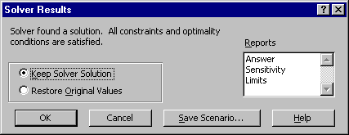
Using Solver -- continued
You can tell it to return the values in the changing cells to their original values or retain the optimal values found by Solver.
In some cases Solver is not able to find an optimal solution, in which case one of several error messages will appear.

Slide 34
Using Solver -- continued
For now, clicking on the OK button to keep the Solver Solution. You should see the solutions shown on the next slide.
The optimal plan is to produce 1000 type 1 frames, 800 type 2 frames, 400 type 3 frames, and no type 4 frames.
This is close to the production plan, but the current plan earns $450 more profit.
Also, it uses all available labor hours and metal, but only 8000 of the 10,000 ounces of glass available.

Slide 35
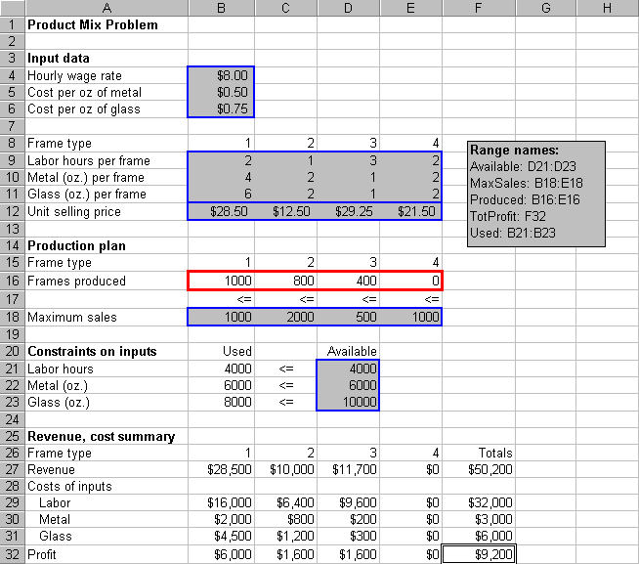

Slide 36
Using Solver -- continued
Finally, in terms of maximum sales, the optimal plan could produce more of frame types 2, 3, 4 (if there were more skilled labor and/or metal available).
This is typical of an LP solution.
Some of the constraints are met exactly; that is, as equalities, while others contain a certain amount of “slack”.

Slide 37
Experimenting
If we want to experiment with different inputs to this problem - the unit revenues or resources available, for example - we can simply change the inputs and then rerun Solver.
As a simple what-if example, consider the modified model in the output on the next slide.

Slide 38
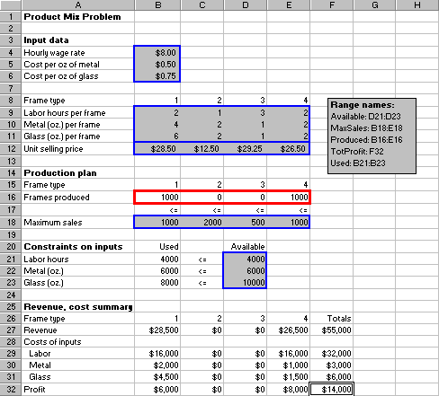
Solution to Product Mix with New Inputs

Slide 39
Experimenting -- continued
Here the unit price for frame type 4 has increased from $21.50 to $26.50, and all other inputs have remained the same.
By making type 4 frames more profitable, we might expect them to enter the optimal mix.
This is exactly what happens.
The new optimal plan discontinues production of frame type 2 and 3, and instead calls for production of 1000 units of frame type 4.

Slide 40
Experimenting -- continued
There is one technical note you should be aware of.
Because of the way the numbers are stored and calculated on a computer, the optimal values in the changing cells and elsewhere can contain small roundoff errors.
For example for all practical purposes .000000008731 can be be treated as 0.

Slide 41
Example 2
A company produces two models of color TV sets, designated A and B. The company’s objective is profit maximization. The profit realized is $300 from set A and $250 from set B. The limitations are:
Only 40 hours of labor each day are available. Labor constraint
Only 45 hours of machine time are available. Machining constraint
Only 12 sets of model A may be sold each day. Marketing constraint
Determine how many sets of each model to produce each day so that total profit is maximized. Use Excel!

Slide 42
Formulation
The Decision Variables:
x₁ = number of model A produced
X₂ = number of model B produced
The Objective Function (total profit):
z = 300x₁ + 250x₂
This is the function to be maximized, as was
demonstrated using a graphical technique
last week in class.

Slide 43
Constraints
Labor Constraint:
2x₁ + x₂ ≤ 40
Machine Constraint:
x₁ + 3x₂ ≤ 45
Marketing Constraint:
x₁ ≤ 12
Non-negativity Constraint (no negative sales):
x₁ ≥ 0 x₂ ≥ 0

Slide 44
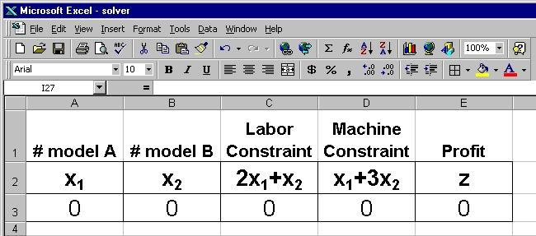
Solver in Excel
First, make the spreadsheet look nice so we
can understand what the heck you are doing.

Slide 45
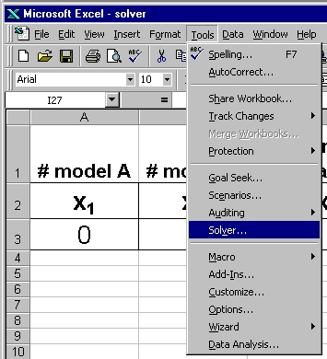
Solver in Excel
From the Tools
menu in Excel
select the Solver.
It will spawn the
menu on the next
slide, into which
you put your
constraints.

Slide 46
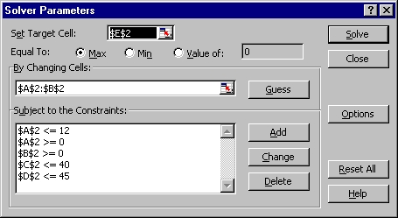
Solver in Excel
The Target Cell is where we want the answer.

Slide 47
Advantages of Linear Programming Model
Linear programming is a tool that can be used to solve allocation type problems. Such problems are very common and extremely important.
Solution is difficult due to the fact that an infinite number of possible solutions may exist.
Linear programming not only provides the optimal solution but does so in a very efficient manner.
It provides additional information concerning the values of the resources that are allocated.

Slide 48
Limitations of LP Due to Assumptions
The applicability of linear programming is limited by several assumptions. As in all mathematical models, assumptions are made for reducing the complex real-world problem into a simplified form. The major ones are:
Certainty - It is assumed that all data involved in the linear programming problem are known with certainty
Linear objective function - It is assumed that the objective function is linear. This means that per unit cost, price or profit are assumed to be unaffected by changes in production methods or quantities produced or sold.

Slide 49
Limitations of LP Due to Assumptions
Linear constraints - The constraints are also assumed to be linear. This means that all the input-output coefficients are considered to be unaffected by a change of methods, quantities, or utilization level.
Nonnegativity - Negative activity levels (or negative production) are not permissable. It is required, therefore, that ll decision variables take nonnegative values.
Additivity - It is assumed that the total utilization of each resource is determined by adding together that portion of the resource required for the production of each of the various products or activities. The assumption of additivity also means that the effectiveness of the joint performance of activities, under any circumstances, equals the sum of the effectiveness resulting from the individual performance of these activities.

Slide 50
Limitations of LP Due to Assumptions
Divisibility - Variables can, in general, be classified as continuous or discrete. Continuous variables are subject to measurement (e.g., weight), temperature
Independence - Complete independence of coefficients is assumed, both among activities and among resources. For example, the price of one produce has no effect on the price of another.
Proportionality - The requirement that the objective function and constraints must be linear is a proportionality requirement. This means that the amount of resources used, and the resulting value of the objective function, will be proportional to the value of the decision variables.

Slide 51
What-if Analysis
Notes:
This presentation discusses What-if Analysis using Microsoft Office Excel 2007.

Slide 52
Objectives
Create a one-variable data table
Create a two-variable data table
Solve problems with Goal Seek
Use Scenario Manager
Load the Solver Add-In
Solve Problems with Solver
Notes:
The objectives of chapter 8 are:
Create a one-variable data table
Create a two-variable data table
Solve problems with Goal Seek
Use Scenario Manager
Load the Solver Add-In
Solve Problems with Solver

Slide 53
Create a one-variable data table
What-if analysis enables you to see how changes in variables affect calculated results
A variable is a value that can be changed to see how those changes impact other values
An independent variable is one that can be controlled directly, such as the price of an item
A dependent variable is one that may vary such as the number of items sold
Notes:
By creating a one-variable data table you can complete what-if analysis to see the impact that changes in variables make on the calculated results.
A variable is a value on the worksheet that you will change. An independent variable is one that is controlled directly. A dependent variable is one that might vary based on different conditions.

Slide 54
Create a One-Variable Data Table
A one-variable data table is a data-analysis tool that provides various results based on changing one variable
Allows you to analyze different values of one variable to compare one or more calculated results that are affected by the variable
Two important elements:
  Input cells contain values to be modified for what-if analysis
  Result cells contain values to be modified
Notes:
A one-variable data table allows you to play with different values for a variable to analyze the outcomes. If you were thinking of purchasing a car, you might change the percentage rate of your loan to see how that would change your payment.
Two important elements are the Input cells and the Result cells.

Slide 55
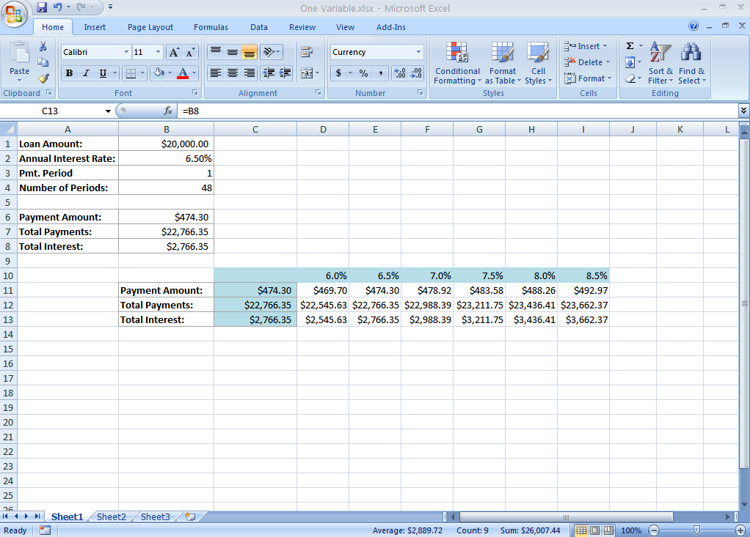
Create a One-Variable Data Table
Notes:
This figure shows a sample of a one-variable data table for the purchase of a car.
Cells D10:I10 contain values for the interest rate variable. Labels in cells B11:B13 describe the contents of the result cells that will be generated.
Cells B6:B8 contain formulas generating the original monthly payment, total payments, and total interest.
Cell C11 contains =B6 to refer to the cell containing the formula that generates the original monthly payment, cell C12 contains =B7 to refer to the cell containing the formula that generates the original total payment, and C13 contains =B8 to refer to the cell containing the formula that generates the original total interest

Slide 56
Create a One-Variable Data Table
To perform the analysis:
  Select the entire table excluding the descriptive labels
  Click the What-If Analysis down arrow in the Data Tools group on the Data tab and select Data Table
  Type the address of the cell to be changed in the Data Table dialog box
  Click OK
Notes:
When analyzing a one-variable data table:
Select the entire table excluding the descriptive labels.
Click the What-If Analysis down arrow in the Data Tools group on the Data tab and select Data Table.
Type the address of the cell to be changed in the Data Table dialog box.
Click OK.

Slide 57
Create a Two-Variable Data Table
Use to determine the affect of two variables on a single formula result
Summarizes important input and output cell values in multiple what-if analyses in one rectangular cell range
Specify two input variables that Excel changes to produce the data table
First variable must be in the left column of the table, and the second variable must be in the top row of the data table
Notes:
Two-variable data tables allow you to consider the effects of two variables on a result.
An example is shown on the next slide.

Slide 58
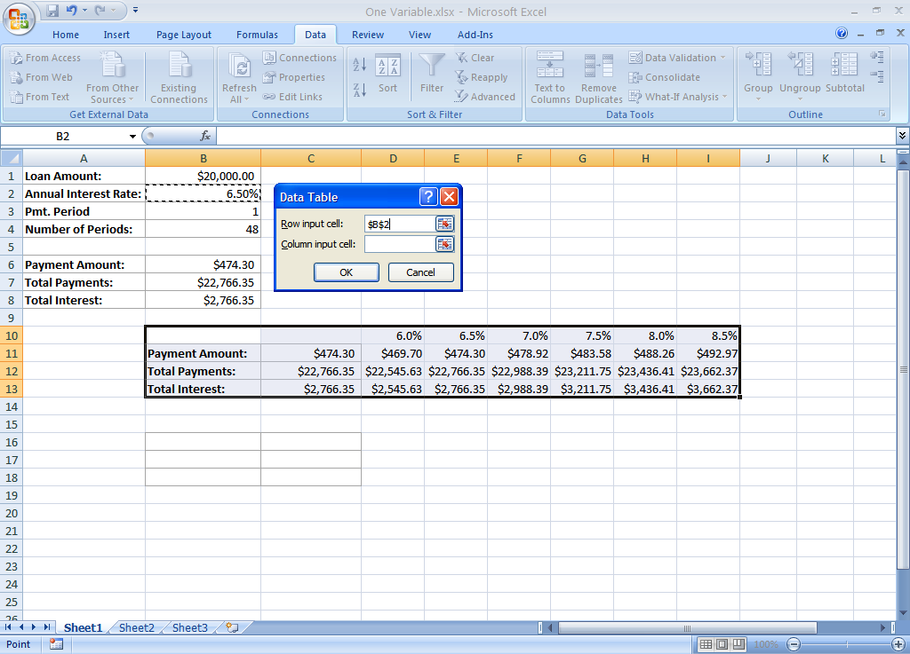
Create a Two-Variable Data Table
Notes:
This figure illustrates a sample of a two-variable data table.

Slide 59
Create a Two-Variable Data Table
Steps to create a two-variable data table:
  Create the data table with appropriate headings, indicating the different values of the two variables
  Create a formula in the top-left corner at the intersection of the column and row headings
    The formula should reference the cell containing the original result formula
  Select the entire data table, including the column and row headings that contain the different values for the two variables
Notes:
To create a two-variable data table:
Create the data table with appropriate headings, indicating the different values of the two variables.
Create a formula in the top-left corner at the intersection of the column and row headings. The formula should reference the cell containing the original result formula.
Select the entire data table, including the column and row headings that contain the different values for the two variables.
The steps continue on the next slide.

Slide 60
Create a Two-Variable Data Table
  Click the What-If Analysis down arrow in the Data Tools group on the Data tab and select Data Table
  Type the cell that contains the original value for the horizontal variable in the Row input cell box, and type the cell that contains the original value for the vertical variable in the Column input cell box
  Click OK
Notes:
The two-variable data table steps continue with:
Click the What-If Analysis down arrow in the Data Tools group on the Data tab and select Data Table.
Type the cell that contains the original value for the horizontal variable in the Row input cell box, and type the cell that contains the original value for the vertical variable in the Column input cell box.
Click OK.

Slide 61
Solve Problems with Goal Seek
Goal Seek is a method for finding one-time solutions to problems
It enables you to work backwards to solve a problem
It enables you to set the end result to determine the input to produce the result
The primary advantage is the dialog box that enables you to change your goals and parameters relatively easily
Notes:
Goal Seek is a method for finding one-time solutions to problems by working from the end result to determine the input to produce that result.

Slide 62
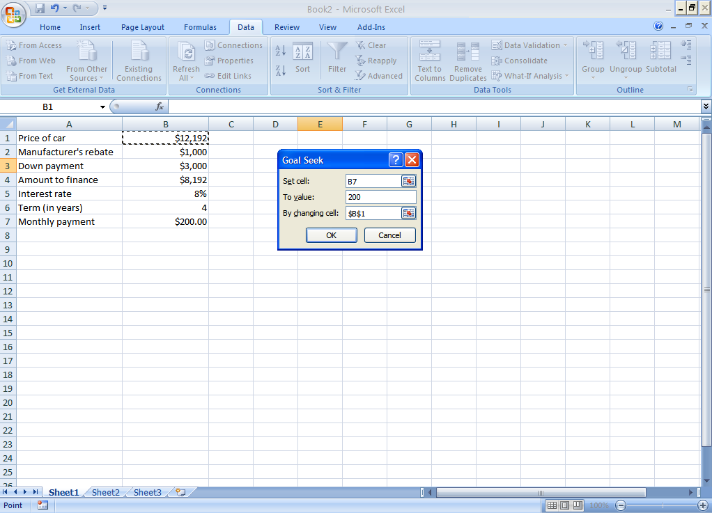
Solve Problems with Goal Seek
Notes:
To use Goal Seek:
1. Select the cell containing the formula for which you want a desired result.
2. Click What-If Analysis in the Data Tool group on the Data tab.
3. Select Goal Seek to open the Goal Seek dialog box.
4. Enter the cell reference for the cell to be optimized in the Set cell box.
5. Enter the result you want to achieve in the To value box.
6. Enter the cell reference that contains the value of the variable to be adjusted in the By changing cell box.
7. Click OK to begin goal seeking.
8. When an answer appears, click OK to accept the change or Cancel to return to the original data.

Slide 63
Use Scenario Manager
Scenario Manager enables you to specify multiple sets of assumptions, called scenarios, to quickly see the results of any given Scenario
Represents different sets of what-if conditions to be considered in assessing the outcome of spreadsheet models
Notes:
Scenarios are saved for a specific worksheet within the workbook and are available when the workbook is opened.
Goal Seek returns one result, indicating rather simple goals. Scenario Manager, on the other hand, enables you to design more sophisticated analysis.

Slide 64
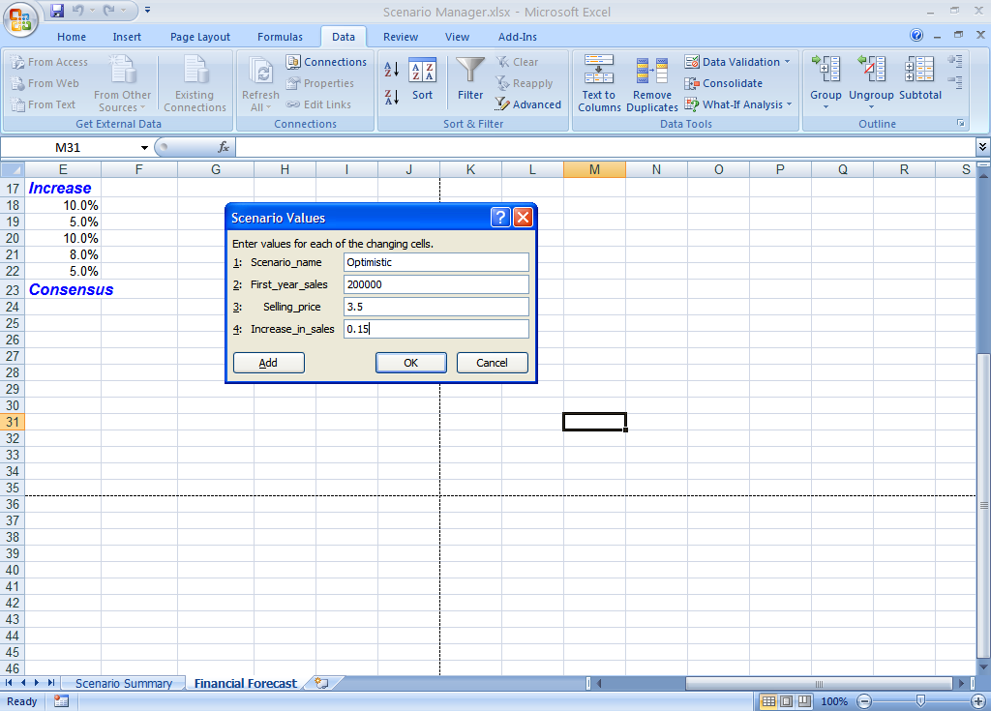
Use Scenario Manager
Notes:
This slide shows the Scenario Manager dialog box with values.

Slide 65
Use Scenario Manager
You can create multiple scenarios using the Add Scenario dialog box
To view your scenarios, click What-If analysis in the Data Tools group on the Data tab, select Scenario Manager, and highlight the name of the Scenario you want to view in the Scenarios list and click Show
A scenario summary report is a condensed version of the scenario results
Copyright © 2008 Pearson Prentice Hall. All rights reserved.
Notes:
To create a scenario summary report:
1. Click What-If Analysis in the Data Tools group on the Data tab.
2. Select Scenario Manager and then click Summary.
3. Click Scenario Summary and enter the reference for the cell(s) that refer to cells whose values change in the scenarios in the Result cells box.
4. Click OK. The scenario summary report appears on a separate worksheet.

Slide 66
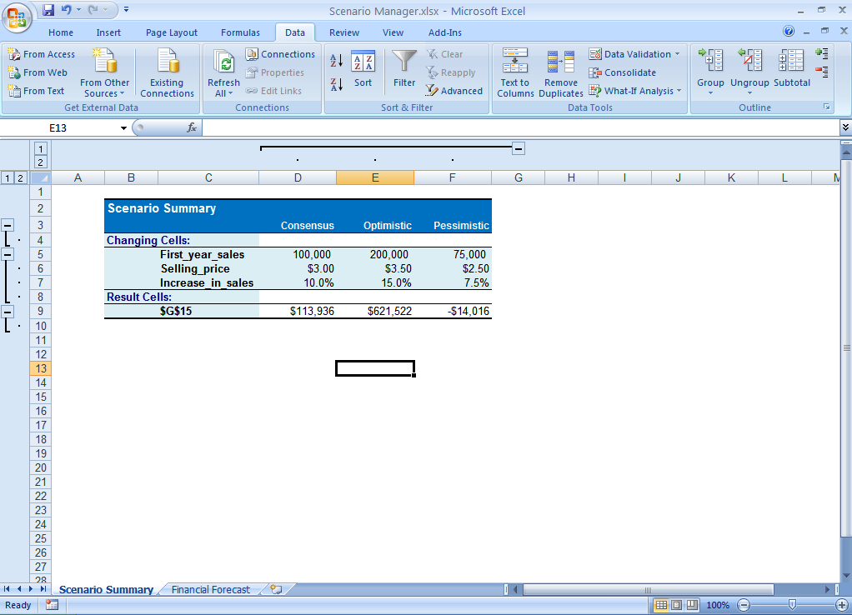
Use Scenario Manager
Copyright © 2008 Pearson Prentice Hall. All rights reserved.
Notes:
This figure illustrates an example of a scenario summary report.

Slide 67
Use Scenario Manager
If you have defined many scenarios with multiple result cells, a Scenario PivotTable report may give you more flexibility in your analysis of outcomes based on your scenarios
Notes:
Consider using a Scenario PivotTable report if you have many scenarios with multiple result cells.

Slide 68
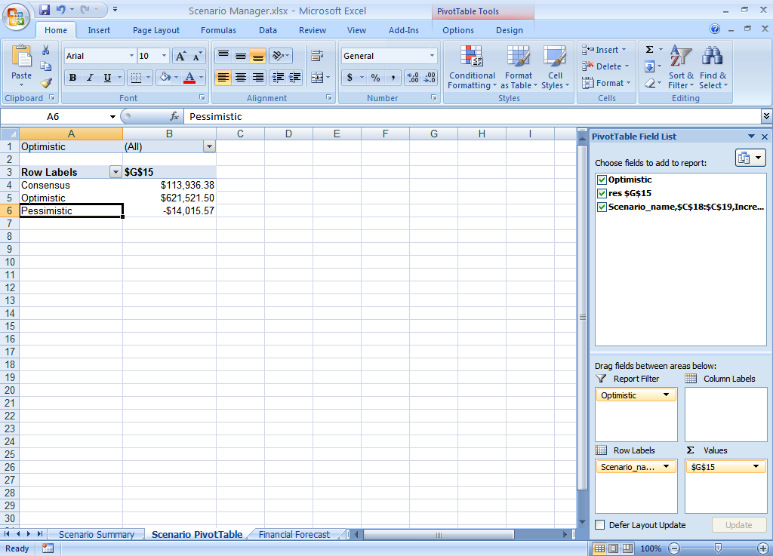
Use Scenario Manager
Notes:
This figure illustrates a scenario summary in the form of a Pivot Table.

Slide 69
Load the Solver Add-in
Solver is a separate program that must be installed or added in to Excel
Once added, it appears in the Analysis group on the Data tab as shown in Figure
To install:
  Click the Office Button
  Click Excel Options
  Click Add-Ins, select Excel Add-ins from the Manage list and click GO
  Click Solve Add-in in the Add-Ins available list and click OK
Notes:
Solver is an add-in program that can be installed in Excel. Once it is installed it will be found on the Data tab in the Analysis group.

Slide 70
Solving Problems with Solver
Solver : an add-in program that searches for the best solution to a problem with several variables
Used to find the best way to allocate resources
Requires three parameters:
  target cell typically contains a formula that is directly or indirectly based on the adjustable cells and constraints
  adjustable cells are the cells whose values are adjusted until the constraints are satisfied
  constraints specify the restrictions
Copyright © 2008 Pearson Prentice Hall. All rights reserved.
Notes:
The Solver searches for the best solution to a problem with several variables. It requires three parameters. The target cell, adjustable cells, and constraints are required.

Slide 71
Solve Problems with Solver
Define the problem
Using identified input ranges, output cells, and constraints, Solver can minimize or maximize the input cell or set the output cell to a particular value
Define the parameters using the Solver dialog box
Notes:
Click Solver in the Analysis group on the Data tab. This opens the Solver Parameters dialog box.
An example is shown on the next slide.

Slide 72
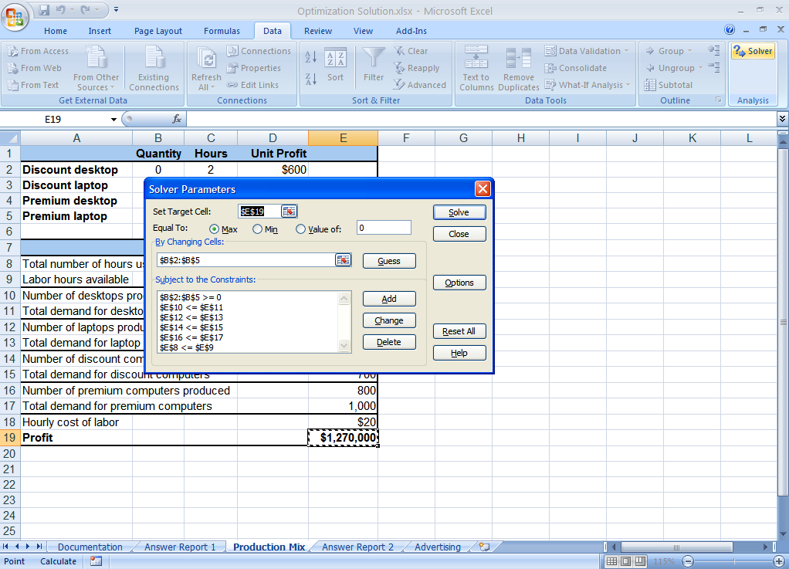
Solving Problems with Solver
Notes:
This figure illustrates the Solver dialog box.

Slide 73
Solve Problems with Solver
Stepping through Solver enables you to view the steps Solver performs
Saving a Solver model places the information in a small block of cells on a worksheet
  Keeps track of your predefined settings
If you want to use an existing Solver model with new or updated data you would return to a previous Solver Model by restoring that model
Notes:
Stepping through Solver lets you see the steps. When you save a Solver model, the information is placed in a small block of cells on the worksheet. If you want to return to an existing Solver model, restore that model.

Slide 74

Notes:
The concept of what-if analysis is an important tool. It allows you to determine the results of scenarios based on variables. Be sure to ask questions as they arise.

